Slide 1





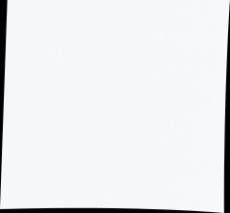
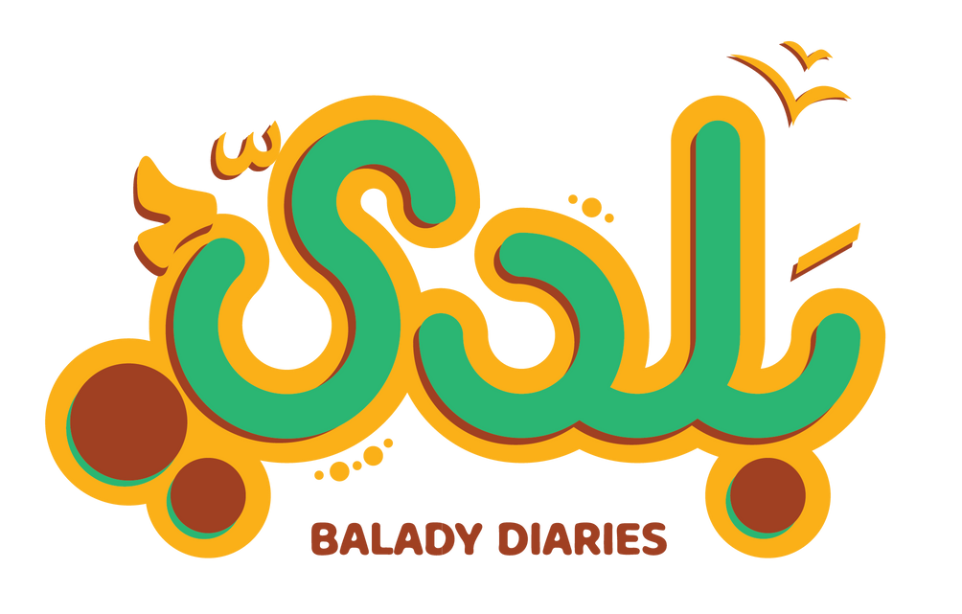



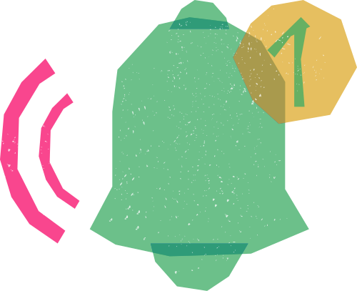
DIGITAL MARKETING
PROJECT OCTOBER 2024

Slide 2
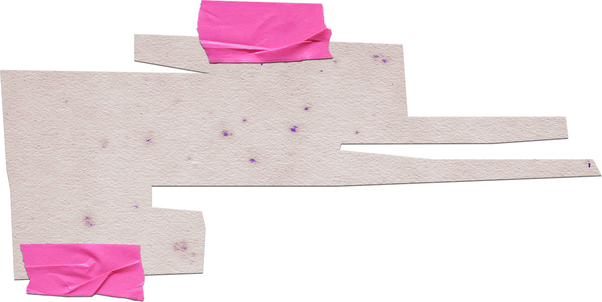
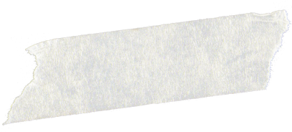



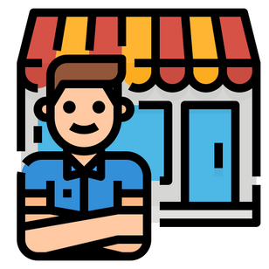

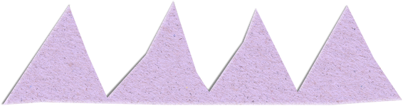
Introduction to BALADY DIARIES
Balady Organic is an Egyptian startup producing 100% organic dairy products that emphasize authenticity and traditional farming methods. Targeting health-conscious urban professionals and families, Balady offers a natural, chemical-free alternative to mass-produced dairy. Its mission is to support local farmers while promoting healthier lifestyle choices through premium organic products.
The Business Case
Balady solves the problem of limited access to fresh, organic dairy products in urban areas like Cairo and Alexandria. Many health-conscious consumers struggle to find chemical-free, nutrient-rich options for their families, particularly for children. By offering locally sourced, 100% organic dairy, Balady ensures customers receive the highest quality products that support both their well-being and sustainable farming.

Slide 3


Vision & Mission BALADY DIARIES
Mission
Vision
To provide customers with fresh, healthy, and delicious dairy products while maintaining high standards of animal welfare and environmental sustainability.
To be a leading producer of premium dairy products known for quality, sustainability, and innovation in the dairy industry.

Slide 4
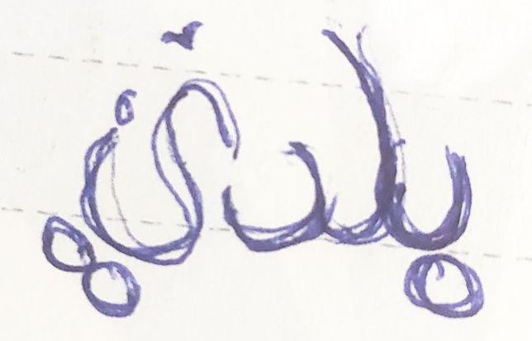
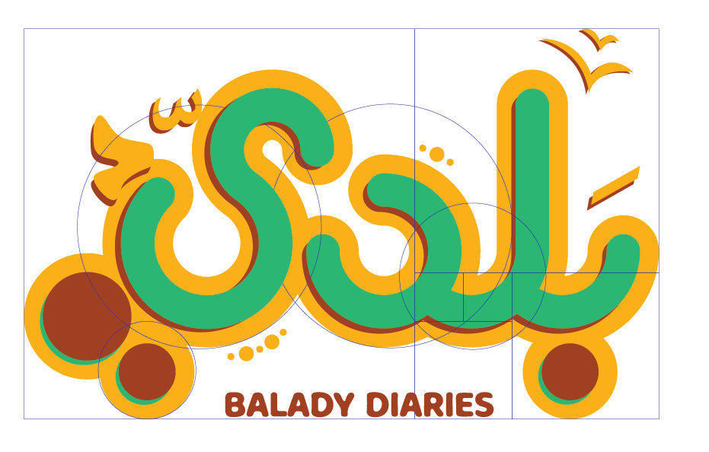
Brand Identity
BALADY DIARIES
Green: For nature, health, and organic growth.
Brown: Earthy tones to evoke the natural
farming soil and simplicity.
Golden: To represent the sun and the warmth
of Egypt’s land and produce.

Slide 5

Design Elements
1- Concept:
The logo reflects values of organic, locally sourced food from rural, countryside areas ("reef") in Egypt.
It authenticity, nature, and simplicity, while also feeling fresh and modern.
2- Visual Inspiration:
Countryside: Reference Egypt’s rural landscape.
Traditional Egyptian Motifs: Egyptian design patterns & typography gives a local touch.
3- Typography:
The Font feels approachable and authentic, hand-drawn quality reflects the farm-to-table aspect.
Arabic calligraphy in a subtle way strengthen the local identity.
4- Tone:
The overall tone of the logo feels natural, wholesome, and trustworthy, appealing to health-conscious consumers who value organic and sustainable food.

Slide 6
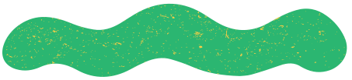
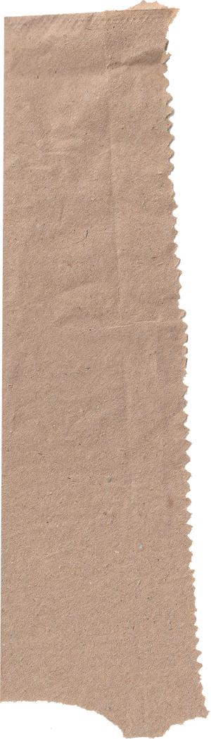

Balady DIARIES Business Model Canvas
Focusing on sustainability, premium quality
dairy products, and customer-centric solutions
Key Partners | Key Activities | Value Proposition | Customer Relationships | Customer Segments
Local farmers for organic feed sourcing Restaurants, hotels, and cafes for wholesale distribution Distribution and logistics partners (refrigerated transport) Packaging suppliers (eco-friendly) Retailers (supermarkets, grocery stores) Health organizations for promotional partnerships Renewable energy providers Marketing and branding agencies Farm equipment suppliers Government agricultural initiatives and grants Data Analyst for customer insights and market analysis | Dairy production and processing (milk, cheese, yogurt, butter, cream) Sustainable farming practices (organic pastures, renewable energy) Quality control and supply chain management Customer relationship management (support, feedback, education) Marketing and branding (emphasizing sustainability and health benefits) Direct sales, wholesale, and subscription services Product innovation (new flavors, lactose-free, organic) Farm tours and educational experiences | 100% organic, authentic dairy products from Egypt’s countryside High-quality, fresh dairy sourced from sustainable, traditional farming methods Health-conscious products with no chemicals or artificial additives Lactose free options Farm experience through farm tours Innovation: Continuous development of new products and flavors Sustainability: Organic farming, eco-friendly processes, renewable energy use Supporting local farmers and the economy Animal Welfare: Humane treatment and care for dairy cows | Personal customer support (handling inquiries, complaints, and feedback) Engaging storytelling and farm-to-table content Customer education (organic benefits, sustainability) Loyalty programs or rewards for frequent buyers Social media engagement to maintain a strong connection with consumers | B2C: Health-conscious consumers seeking organic and natural products Families, especially parents interested in healthy options for their children Environmentally conscious consumers looking for sustainable brands Food enthusiasts interested in traditional and local products B2B hospitals that care about the quality of food for patience Hotels Restaurants and foodservice businesses that prioritize organic ingredients
Local farmers for organic feed sourcing Restaurants, hotels, and cafes for wholesale distribution Distribution and logistics partners (refrigerated transport) Packaging suppliers (eco-friendly) Retailers (supermarkets, grocery stores) Health organizations for promotional partnerships Renewable energy providers Marketing and branding agencies Farm equipment suppliers Government agricultural initiatives and grants Data Analyst for customer insights and market analysis | Key Resources | 100% organic, authentic dairy products from Egypt’s countryside High-quality, fresh dairy sourced from sustainable, traditional farming methods Health-conscious products with no chemicals or artificial additives Lactose free options Farm experience through farm tours Innovation: Continuous development of new products and flavors Sustainability: Organic farming, eco-friendly processes, renewable energy use Supporting local farmers and the economy Animal Welfare: Humane treatment and care for dairy cows | Channels | Competitors
Local farmers for organic feed sourcing Restaurants, hotels, and cafes for wholesale distribution Distribution and logistics partners (refrigerated transport) Packaging suppliers (eco-friendly) Retailers (supermarkets, grocery stores) Health organizations for promotional partnerships Renewable energy providers Marketing and branding agencies Farm equipment suppliers Government agricultural initiatives and grants Data Analyst for customer insights and market analysis | Organic farms and livestock (core of dairy production) Farm infrastructure (modern milking and processing facilities) Organic pastures and grazing land Skilled labor for dairy production and farm management Capital investment (for land, machinery, and initial marketing) Strong brand identity (premium, fresh, sustainable) Distribution network (for delivering fresh products) Packaging and storage facilities | 100% organic, authentic dairy products from Egypt’s countryside High-quality, fresh dairy sourced from sustainable, traditional farming methods Health-conscious products with no chemicals or artificial additives Lactose free options Farm experience through farm tours Innovation: Continuous development of new products and flavors Sustainability: Organic farming, eco-friendly processes, renewable energy use Supporting local farmers and the economy Animal Welfare: Humane treatment and care for dairy cows | Organic and health food stores Supermarkets that specialize in organic or local products Direct sales through Balady’s website or e-commerce platforms Farmer’s markets and local fairs Partnerships with restaurants, cafés, and food delivery services Social media and digital marketing channels for awareness and direct engagement | Local organic dairy brands in Egypt Imported organic dairy brands Conventional dairy brands with natural/eco-friendly product lines Large supermarkets offering private-label organic products Small-scale organic farms selling directly to customers or at markets
Cost Structure | Revenue Streams
Organic dairy farming and production costs Packaging costs (sustainable materials) Distribution and logistics (refrigerated transport) Certification fees (organic compliance) Labor and operational costs (farm staff, sales, customer service) Marketing and branding expenses (digital ads, partnerships, influencers) Equipment maintenance and upgrades (farming machinery, refrigeration) | B2C Direct sales through retail partners (supermarkets, organic stores) Online sales via e-commerce or delivery platforms Subscription-based models for regular deliveries of dairy products Event-based sales at farmer’s markets and local fairs Custom products for health-focused retailers (yogurt, specialty cheeses, etc.) B2B Restaurant, Hotels, Hospital and café partnerships for bulk sales

Slide 7
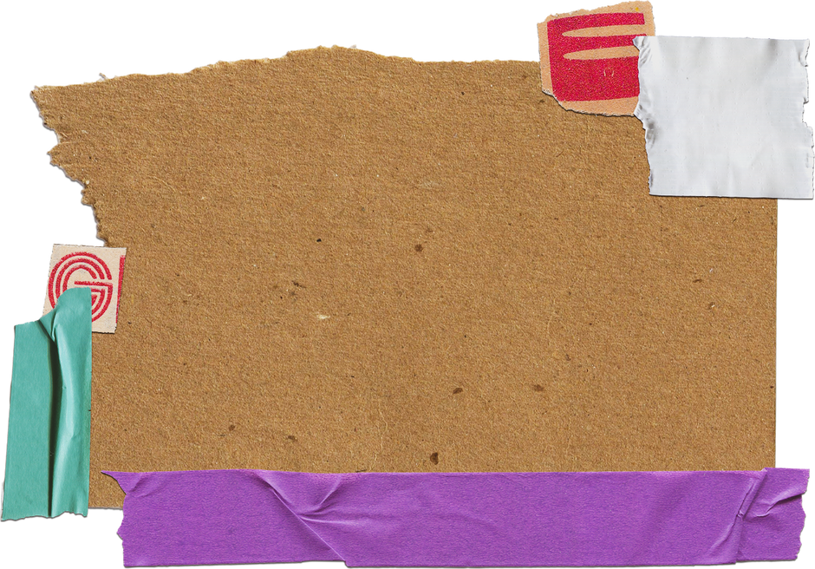

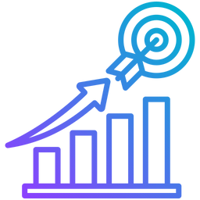





Business, Marketing & Digital Marketing Objectives
BUSINESS OBJECTIVES
MARKETING
OBJECTIVES
DIGITAL
MARKETING
Objectives
Increase brand awareness of Baldy Dairies among urban families in Egypt within the next 12 months.
Specific: Focus on increasing brand awareness among urban families.
Measurable: Target a 40% of urban families, which can be tracked through brand recognition surveys and digital analytics.
Achievable: The target is ambitious yet attainable with strategic marketing efforts.
Relevant: Enhancing brand awareness is crucial for gaining market share in a competitive industry.
Time-bound: Set for the next 12 months.
Achieve a 70% of market share in the organic dairy segment in Egypt within 24 months
Specific: Focus on capturing a significant share of the organic dairy market.
Measurable: Market share can be measured through industry reports and sales data.
Achievable: With the right strategy, this target is within reach.
Relevant: A higher market share will solidify Baldy Dairies' position as a leading organic dairy brand.
Time-bound: Set for 24 months.
Grow social media followers and engagement within the next 6 months through organic and paid campaigns.
Specific: Target both follower growth and engagement.
Measurable: Use social media analytics to track followers and engagement rates.
Achievable: Realistic growth targets with a balanced mix of organic and paid efforts.
Relevant: Social media growth is vital for increasing brand visibility and customer interaction.
Time-bound: 6-month deadline.

Slide 8





SWOT ANALYSIS FOR MACRO-ENVIROMENT
S
W
STRENGTHS
WEAKNESSES
High-Quality Products
Commitment to Sustainability
Diverse Product Range
Strong Brand Identity
Local Market Knowledge
Limited Distribution Channels
Price Sensitivity
Dependence on Local Market
Limited Marketing Resources
O
T
OPPORTUNITIES
THREATS
Growing Demand for Health-Conscious Products
Expansion into New Markets
Innovative Product Development
Partnerships and Collaborations
Digital Marketing Growth
Intense Competition
Economic Uncertain
Regulatory Changes
Supply Chain Disruptions
Shifting Consumer Preferences

Slide 9



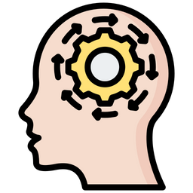
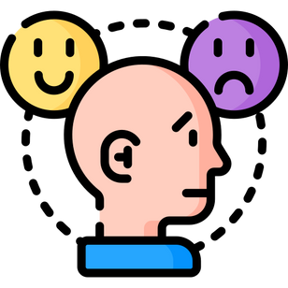


Market Segmentation
Divide Egyptian market into groups based on their traits, needs, or behavior
Demographic
Geographic
Psychographic
Behavioral
Age: Focus on younger generations, such as millennials and Gen Z, who are more health-conscious and open to new trends.
Income: Target middle to upper-middle-class consumers who have the purchasing power to afford premium organic products.
Family Status: Consider targeting young families who are looking for healthier options for their children.
Urban Areas: Concentrate on major cities like Cairo and Alexandria, where there's higher awareness and demand for organic products.
Affluent Suburbs: Target suburban areas around these cities where there is a higher concentration of higher-income families.
Lifestyle: Appeal to consumers who lead a healthy lifestyle and are interested in fitness, wellness, and organic food.
Values: Focus on individuals who are concerned about environmental sustainability and ethical sourcing.
Affluent Suburbs: Target suburban areas around these cities where there is a higher concentration of higher-income families.
Benefits Sought: Target those looking for healthier, chemical-free food options.
User Status: Identify early adopters of organic products and those transitioning from conventional to organic.

Slide 10
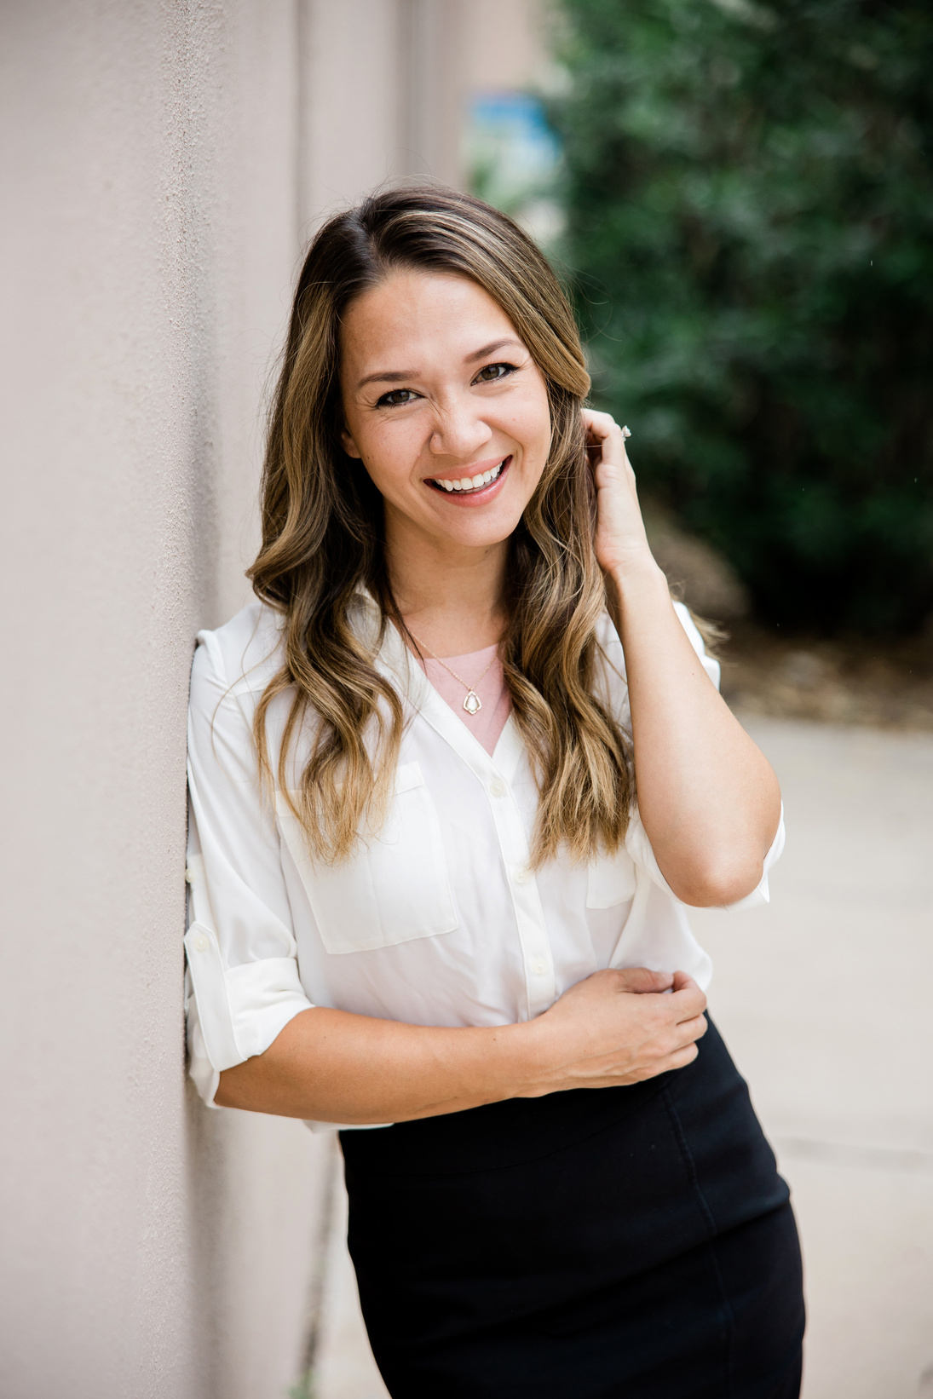



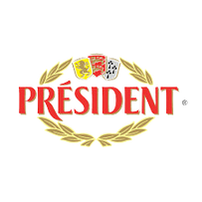
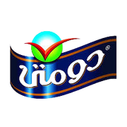
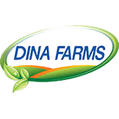
MARKET PERSONA
BIO
MOTIVATION
Aya is 35 years old, She is interior designer her income is 15k, she is married living in Heliopolis and interested in organic food looking for healthier options for her children.
Health Consciousness, Environmental Impact, Connection to Traditio, Social Awareness & Familly oriented.
GOALS
PERSONALITY
Healthy Lifestyle, Supporting Local Brands, Sustainable Design & Work-Life Balance.
Design Thinking
Resource
SKILLS
FAVORITE BRANDS
Aya Ahmed
Problem Solving
Interior Designer
Public Speaking
Smart
Honest
Loyal

Slide 11
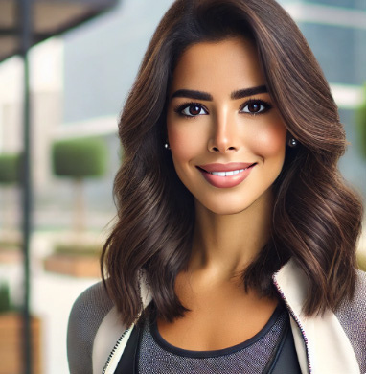
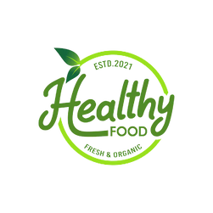
MARKET PERSONA
BIO
MOTIVATION
Nourhan is 29 years old an early riser who starts her day with a workout, either at the gym or through yoga. She maintains a balanced diet, focusing on organic and locally-sourced foods. On weekends, she enjoys exploring new restaurants that offer healthy options.
Nourhan is motivated by the desire to maintain a healthy lifestyle and to feel good about her purchasing decisions. She believes that supporting local, organic brands contributes to the well-being of her community and the environment.
GOALS
PERSONALITY
To live a healthier, more balanced lifestyle while supporting brands that align with her values. Nourhan aims to inspire others in her circle to make healthier choices.
Healthy
Friendly
SKILLS
FAVORITE BRANDS
Nourhan El-Sayed
knowledge
Marketing Executive at a Tech Start-Up
Exploring new organic food
Brand Loyality
Smart
Leader

Slide 12

BALADY DIARIES BRAND VOICE
BALADY Dairies brand voice and tone are carefully crafted to align with its business model, target audience, and product offerings. By maintaining a voice that is friendly, health-conscious, trustworthy, sustainability-focused, and community-oriented, Marky effectively communicates its values and builds a strong, lasting connection with its customers. This approach ensures that the brand not only meets the needs of its audience but also creates a loyal customer base that shares its commitment to quality, health, and sustainability.
1. Friendly and Approachable
2. Health-Conscious and Educative
3. Trustworthy and Transparent
4. Sustainability-Focused
5. Community-Oriented and Inclusive
Example:
"At BALADY DIAIES, we believe that nourishing your family should be simple, delicious, and worry-free. Our products are made with love and care, just like how you would make them at home."

Slide 13


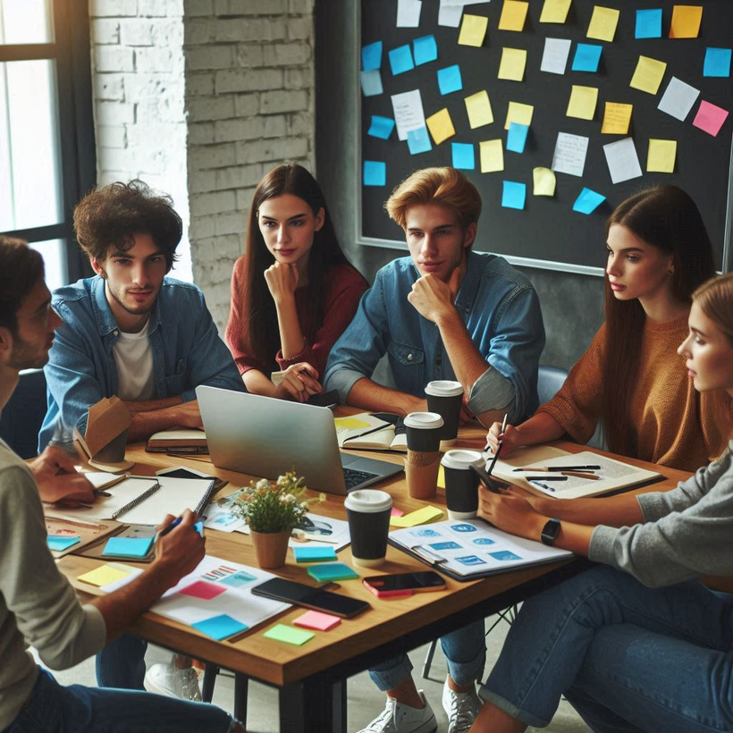
BALADY DIARIES DIGITAL MARKETING
1
Social Media:
Instagram and Facebook: Great for visual storytelling and engaging with health-conscious consumers. high-quality images, videos, and ads showcase the benefits and quality of organic products.
LinkedIn: We will use for reaching professionals and businesses that align with product values, especially for B2B partnerships.
2
Google Ads:
Search Ads: Target keywords related to organic dairy products to reach consumers actively searching for these products.
Display Ads: banners to increase brand awareness across relevant websites and apps.

Slide 14
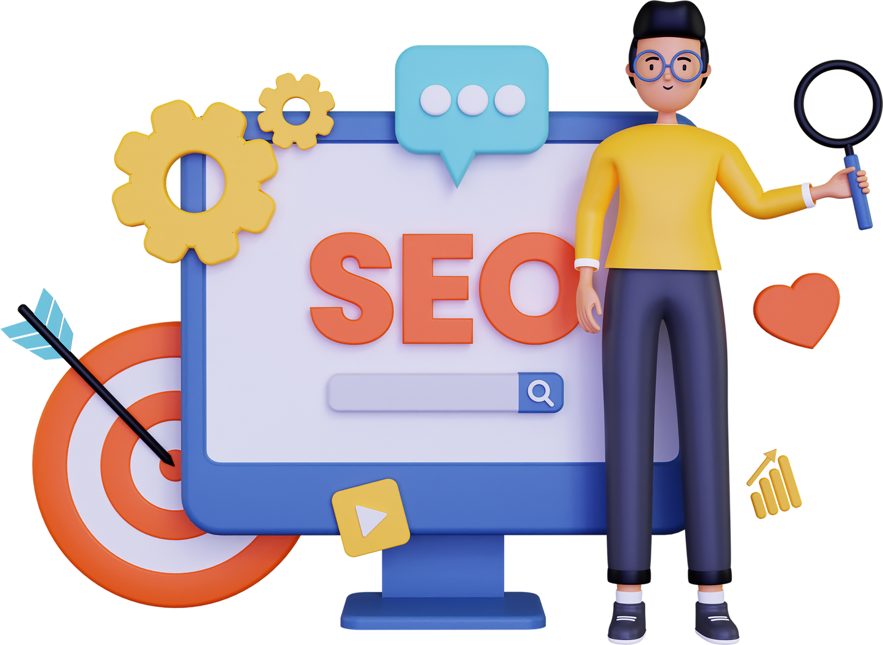



Seo &
Keyword Research
Objective
organic dairy products
Input Seeds
"organic dairy products,"
"organic milk Egypt,"
"healthy dairy options,”
"organic yogurt," etc.
Analyze Keyword Suggestions
suggestions Google provides.
Metrics like search volume, competition, and cost-per-click (CPC)
We will focus on keywords with high search volume and low competition that align with the target audience.

Slide 15



CAMPAIGN
example
Organic Dairy Products for Families
Ad Group: "Organic Milk for Families"
Keywords: "best organic milk for families," "organic milk for kids," "family-friendly organic dairy."
Ad Group: "Healthy Dairy for Children"
Keywords: "healthy organic milk for kids," "organic yogurt for toddlers," "organic cheese for children."

Slide 16
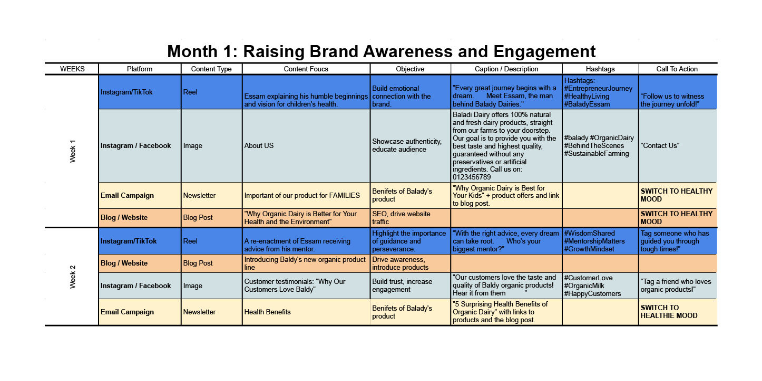
CONTENT
CALENDER

Slide 17
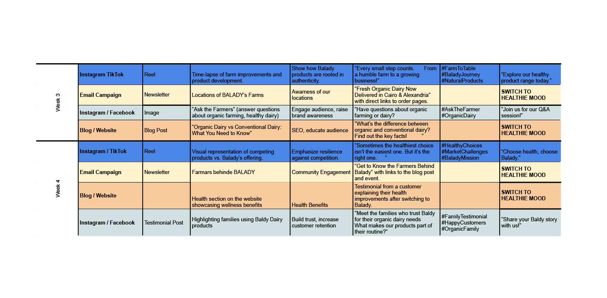
CONTENT
CALENDER

Slide 18
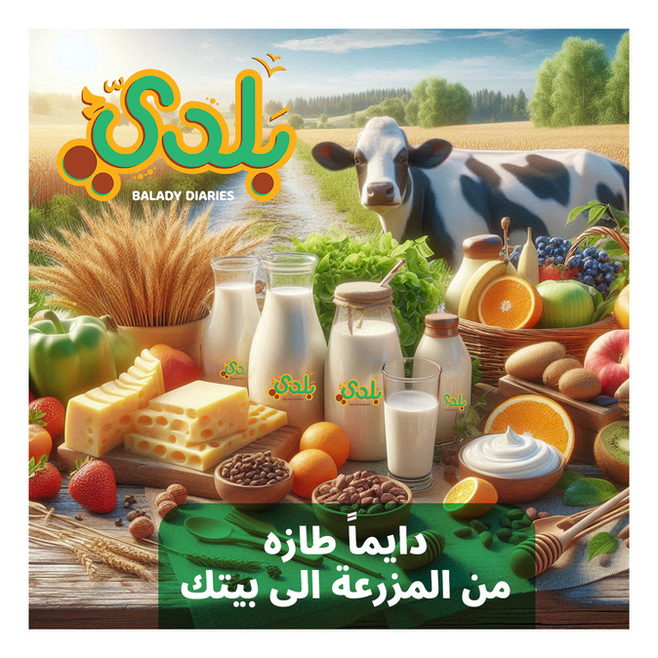
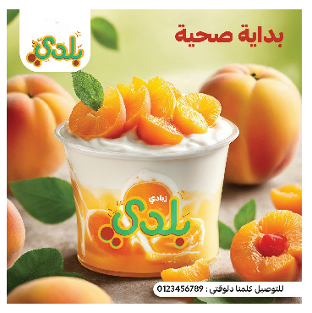
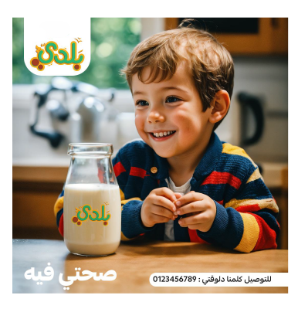
CONTENT DESIGN
Post 1
Post 2
Post 3
% شركة بلدي بتقدملكم منتجات ألبان طبیعیة وطازجة 100
، مباشرة من مزارعنا لأبواب بیوتكم. ھدفنا إنك تستمتع
بأحلى طعم وأعلى جودة، وكل منتجاتنا مضمونة بدون مواد
حافظة أو صناعیة.
كلمنا دلوقتي علي: 0123456789 نوصلك لحد بیتك.
Baladi Dairy offers 100% natural and fresh
dairy products, straight from our farms to
your doorstep. Our goal is to provide you
with the best taste and highest quality,
guaranteed without any preservatives or
artificial ingredients.Call us on: 0123456789
زبادي بلدي هو الاختيار المثالي لأولادك علشان يبدأوا يومهم في المدرسة بشكل صحي ومليء بالطاقة. مكوناته طبيعية 100% وطعمه لذيذ!
كلمنا دلوقتي علي: 0123456789 نوصلك لحد بيتك.
Baladi Yogurt is the perfect choice for your kids to start their school day in a healthy and energetic way. Made with 100% natural ingredients and tastes delicious! Call us on: 0123456789
لبن بلدي غني بالكالسيوم والمعادن والفيتامينات اللي بتدعم صحة ونمو أولادك. احرص على تقديم كوب لبن طبيعي يوميًا لأفضل رعاية لهم.
كلمنا دلوقتي علي: 0123456789 نوصلك لحد بيتك.
Baladi Milk is rich in calcium, minerals, and vitamins that support your children’s health and growth. Make sure to offer them a glass of natural milk daily for the best care.
Call us on: 0123456789

Slide 19




advertisement
Platforms
1
Instagram & Facebook:
Engaging visuals
2
TikTokShort, creative video
3
Google Ads: Search and display ads

Slide 20
advertisement budget
Ads Budget (Total: EGP 62,000 per month):
Instagram & Facebook Ads: EGP 25,000
SEO (Google Ads): EGP 12,000
TikTok Ads: EGP 15,000
Website Marketing (email & pop-ups): EGP 8,000
Email Marketing Campaigns: EGP 2,000

Slide 21



Analytics and Measurement
1
Importance of analytics in digital marketing.
2
Key metrics to track for each digital marketing channel.
3
Tools for analytics and reporting.

Slide 22
KPIs to Tack
Reach & Impressions
Engagement Rate
Click-Through Rate (CTR)
Conversion Rate
Customer Acquisition Cost (CAC)

Slide 23





Mobile Marketing
1
Rise of mobile marketing and its significance.
2
Strategies for mobile-friendly websites and apps.
3
Location-based marketing tactics.

Slide 24
Email Marketing Strategy
Campaign Goals:
Increase brand awareness and conversion rates.
Engage subscribers with special offers (e.g., 10% off for abandoned carts).
Promote subscription deals and product bundles
Content Focus:
Highlight health benefits, sustainability, and product quality through educational content.
Use personalized emails and attractive visuals to drive engagement.

Slide 25
Google advertisement
Google Ads Strategy for Balady Farm
Goal: Boost online visibility and drive product sales.
Ad Types:
Search Ads: Target users searching for dairy products.
Shopping Ads: Showcase dairy products in search results.
Target Audience:
Health-conscious consumers in Egypt, especially Cairo and Alexandria.
Interests: Organic foods, sustainability, premium dairy.
Keywords:
A2 milk, organic dairy, lactose-free products, farm-to-table Egypt.

Slide 26

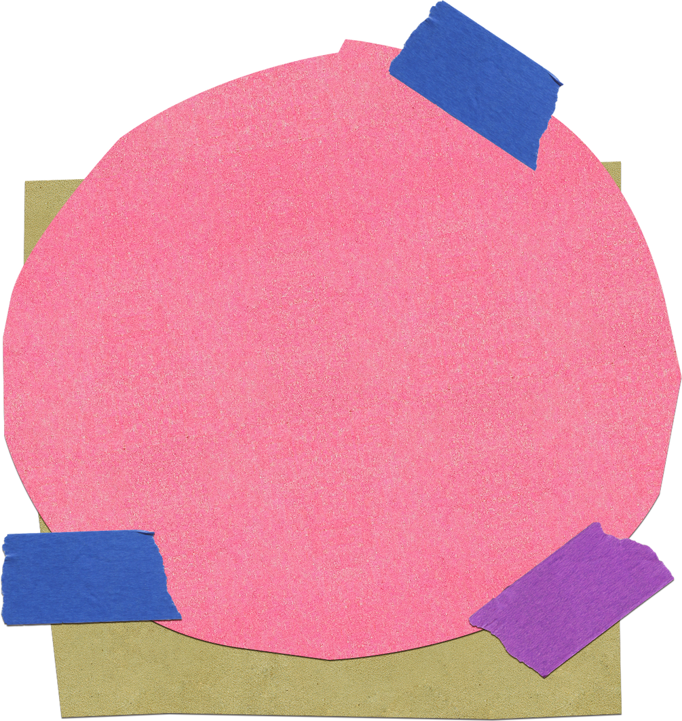
Thank You
Mena Sobhy Haron
Mostafa Hemida
Philemon Emil
Abanoub Nemr
Mohamed Sobh

